Slide 1
Design and Analysis of Algorithms

Slide 2
Example Sorting (Insertion Sort)
Insertion-Sort(A,n) → A[1 … n]
for j = 2 to n
key = A[j]
i = j-1
while i > 0 and A[i] > key
A[i+1] = A[i]
i = i -1
A[i+1] = key
1
i
j
n
key
sorted

Slide 3
Running time of Insertion Sort
The running time depends on the input: an already sorted sequence is easier to sort.
Parameterize the running time by the size of the input,
short sequences are easier to sort than long ones.
Generally, we seek upper bounds on the running time, because everybody likes a guarantee.

Slide 4
Kinds of Analyses
Worst-case: (Usually)
T(n) = (maximum time of algorithm) on any input of size n.
Average-case (Sometimes):
T(n) = (expected time of algorithm) over all inputs of size n.
Need assumption of statistical distribution of inputs
Best-case: (bogus)
Cheat with a slow algorithm that works fast on some input

Slide 5
Analysis of Insertion Sort
Time to compute the running time as a function of the input size
1.for j=2 to length(A)
2. do key=A[j]
3.“insert A[j] into the sorted sequence A[1..j-1]”
4. i=j-1
5. while i>0 and A[i]>key
6. do A[i+1]=A[i]
7. i--
8. A[i+1]=key
cost c₁
c₂
0
c₄
c₅
c₆
c₇
c₈
times n n-1 n-1 n-1 n-1

Slide 6
Insertion-Sort Running Time
T(n) = c₁ • (n) + c₂ • (n-1) + c₃ • (n-1) +
c₄ • (n-1) + c₅ • (Σ_{j=2,n} t_{j}) +
c₆ • ( Σ_{j=2,n} (t_{j} -1) ) + c₇ • ( Σ_{j=2,n} (t_{j} -1) )
+ c₈ • (n-1)
c₃ = 0, of course, since it’s the comment

Slide 7
Best/Worst/Average Case
Best case: elements already sorted, t_{j}=1, running time = f(n), i.e., linear time.
Worst case: elements are sorted in inverse order, t_{j}=j, running time = f(n²), i.e., quadratic time
Average case: t_{j}=j/2, running time = f(n²), i.e., quadratic time

Slide 8
Best Case Result
Occurs when array is already sorted.
For each j = 2, 3,…..n we find that A[i]<=key in line 5 when i has its initial value of j-1.
T(n) = c₁ • n + (c₂ + c₄) • (n-1) + c₅ • (n-1)+ c₈ • (n-1)
= n • ( c₁ + c₂ + c₄ + c₅ + c₈ )
+ ( -c₂ – c₄ - c₅ – c₈ )
= c₉n + c₁₀
= f₁(n¹) + f₂(n⁰)

Slide 9
Worst Case T(n)
Occurs when the loop of lines 5-7 is executed as many times as possible, which is when A[] is in reverse sorted order.
key is A[j] from line 2
i starts at j-1 from line 4
i goes down to 0 due to line 7
So, t_{j} in lines 5-7 is [(j-1) – 0] + 1 = j
The ‘1’ at the end is due to the test that fails, causing exit from the loop.

Slide 10
Worst Case T(n), ctd.
T(n) = c₁ • [n]+ c₂ • (n-1) + c₄ • (n-1)
+ c₅ • (Σ_{j=2,n} j)+ c₆ • [ Σ_{j=2,n} (j -
1) ] + c₇ • [ Σ_{j=2,n} (j -1) ]+ c₈ •
(n-1)

Slide 11
Worst Case T(n), ctd.
T(n) =
c₁ • n + c₂ • (n-1) + c₄ • (n-1) + c₈ • (n-1)
+ c₅ • (Σ_{j=2,n} j)
+ c₆ • [ Σ_{j=2,n} (j -1) ]+ c₇ • [ Σ_{j=2,n} (j -1) ]
= c₉ • n + c₁₀ + c₅ • (Σ_{j=2,n} j) + c₁₁ •
[Σ_{j=2,n} (j -1) ]

Slide 12
Worst Case T(n), ctd.
T(n) = c₉ • n + c₁₀ + c₅ • (Σ_{j=2,n} j) + c₁₁ • [ Σ_{j=2,n} (j -1) ]
But
Σ_{j=2,n} j = [n(n+1)/2] – 1
so that
Σ_{j=2,n} (j-1) = Σ_{j=2,n} j – Σ_{j=2,n} (1)
= [n(n+1)/2] – 1 – (n-2+1)
= [n(n+1)/2] – 1 – n + 1 = n(n+1)/2 - n
= [n(n+1)-2n]/2 = [n(n+1-2)]/2 = n(n-1)/2
Wasn’t that fun?

Slide 13
Worst Case T(n), ctd.
In conclusion,
T(n) = c₉ • n + c₁₀ + c₅ • [n(n+1)/2] – 1 + c₁₁ • n(n-1)/2
= c₁₂ • n² + c₁₃ • n + c₁₄
= f₁(n²) + f₂(n¹) + f₃(n⁰)

Slide 14
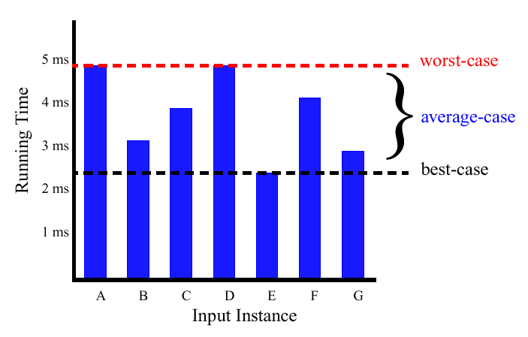
Best/Worst/Average Case (2)
For a specific size of input n, investigate running times for different input instances:
6n
5n
4n
3n
2n
1n

Slide 15
Insertion Sort Analysis
Is insertion sort a fast sorting algorithm?
Moderately so, for small n
Not at all, for large n

